Slide 1
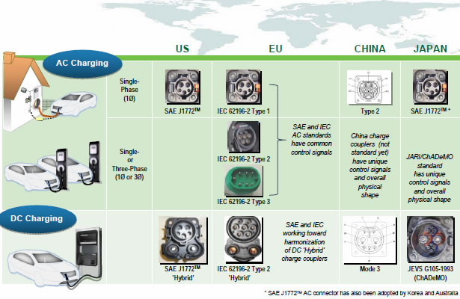
Charging time for 100 km of BEV range | Power supply | Voltage
3–4 hours | Single phase - 7 kW | 230 VAC
2–3 hours | Three phase - 10 kW | 400 VAC
1–2 hours | Three phase - 22 kW | 400 VAC
20–30 minutes | Three phase - 43 kW | 400 VAC
20–30 minutes | Direct current - 50 kW | 400 - 500 VDC
10 minutes | Direct current - 120 kW | 300 - 500 VDC

Slide 2
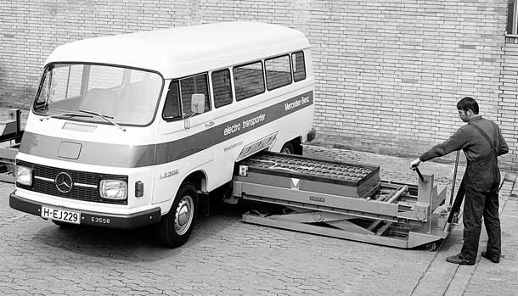
Less then 5 minutes
No need to own battery
maintenance costs switch station company.
Capital costs switch station company.
Technology costs switch station company.
Battery life costs switch station company.
The spare batteries at swap stations could participate in vehicle to grid storage

Slide 3
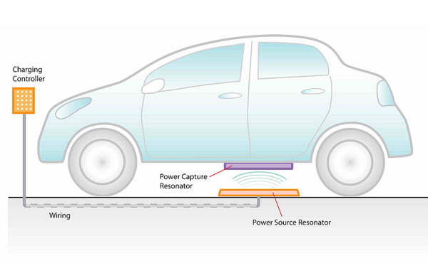
Safe
Flexible
Over %91 efficiency with 10’’
Unaffected up to %25 misalignment
No need to remember connecting cable
No moving parts
Waterproof
Bus stations (predefined routes and planned stops)

Slide 4
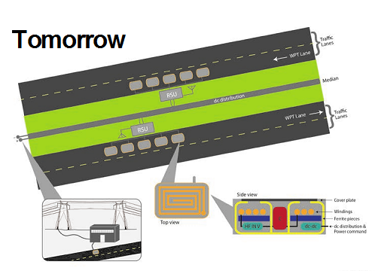
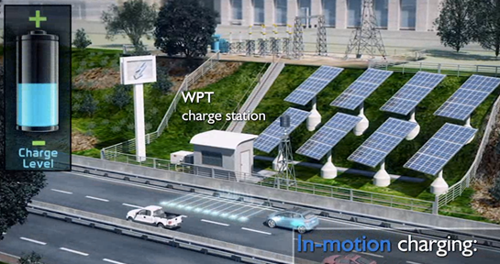
On roads (in-motion charging)
Possible for normal speed in city.
Traffic congestion allows longer charge times

